Slide 1
Financing ECE- ECD In Pakistan
ARNEC Conference - Singapore - November 18-20 2013
Baela Raza Jamil –
Idara-e-Taleem-o-Aagahi-(ITA) Centre for education and ConSciousness Pakistan &
South Asia Forum for Education Development (SAFED)

Slide 2
Target Population for ECD and ECE in Pakistan
Target Age Group as % of Total Population
ECD : 0-8 Years = 24.22 %
ECE : 3-5 Years = 8.5 %
Source: Pakistan Social Living Standards Measurements survey (PLSMs) 2011-2012

Slide 3
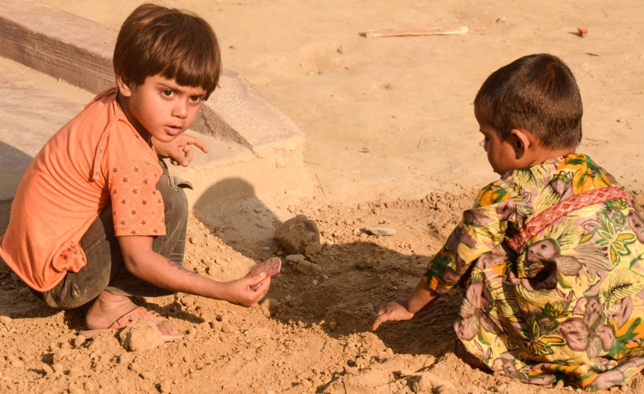
Pre-School Enrollment (3-5 Years) – Rural
% Children who attend different types of pre-schools
Age group | Govt. | Non-state providers |  |  | Out-of-school | Total
 |  | Pvt. | Madrasah | Others
3 | 6.0 | 2.9 | 0.3 | 0.1 | 90.7 | 100
4 | 21.2 | 10.3 | 0.6 | 0.3 | 67.6 | 100
5 | 45.5 | 15.4 | 0.9 | 0.4 | 37.8 | 100
3-5 | 26.2 | 10.0 | 0.6 | 0.3 | 62.9 | 100
Total | 37.1 |  |  |  | 62.9 | 100
By type | 70.5 | 27.0 | 1.7 | 0.7
Enrollment of children of 3 – 5 years 37% in 2012 -Rural
Enrollment highest in Urban 55%
Note on Data: Annual Status of Education Report (ASER) 2012 Survey of 4,033 villages in 80,209 households across Pakistan. A total number of 57,503 children (47% girls, 53% boys) were found in 3-5yrs age group. ECE in Public Sector 70.5 % -ECE in Private Sector 29.5 %

Slide 4
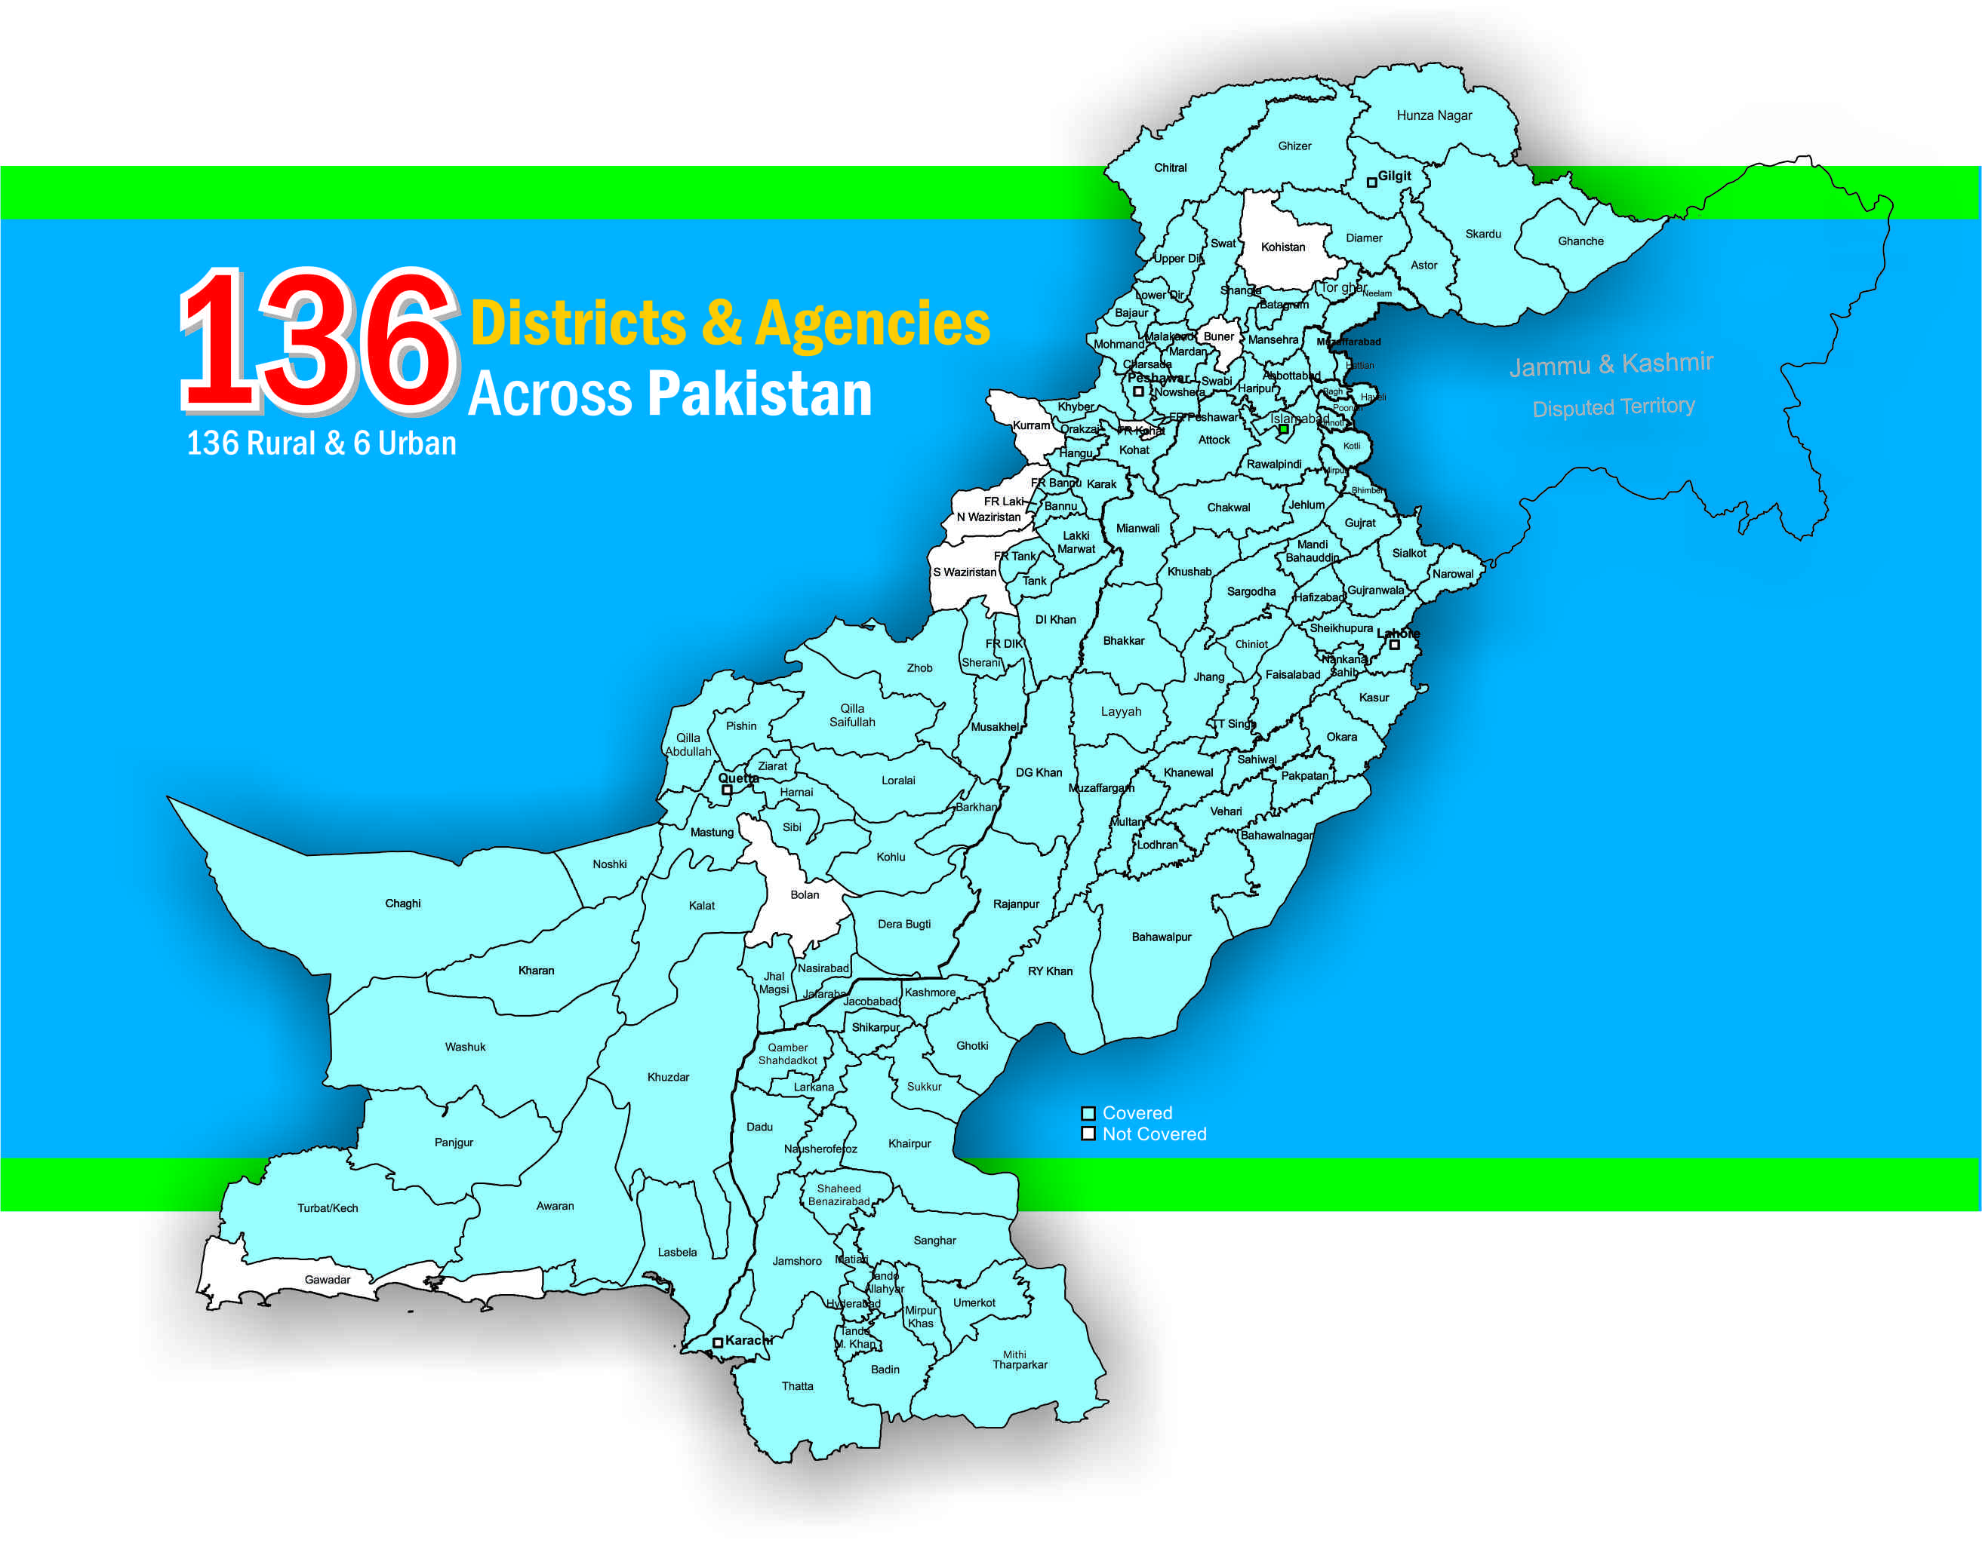
ASER Outreach over the last 3 years
2010 – 32 districts
2011 – 85 districts
2012 – 142 districts

Slide 5
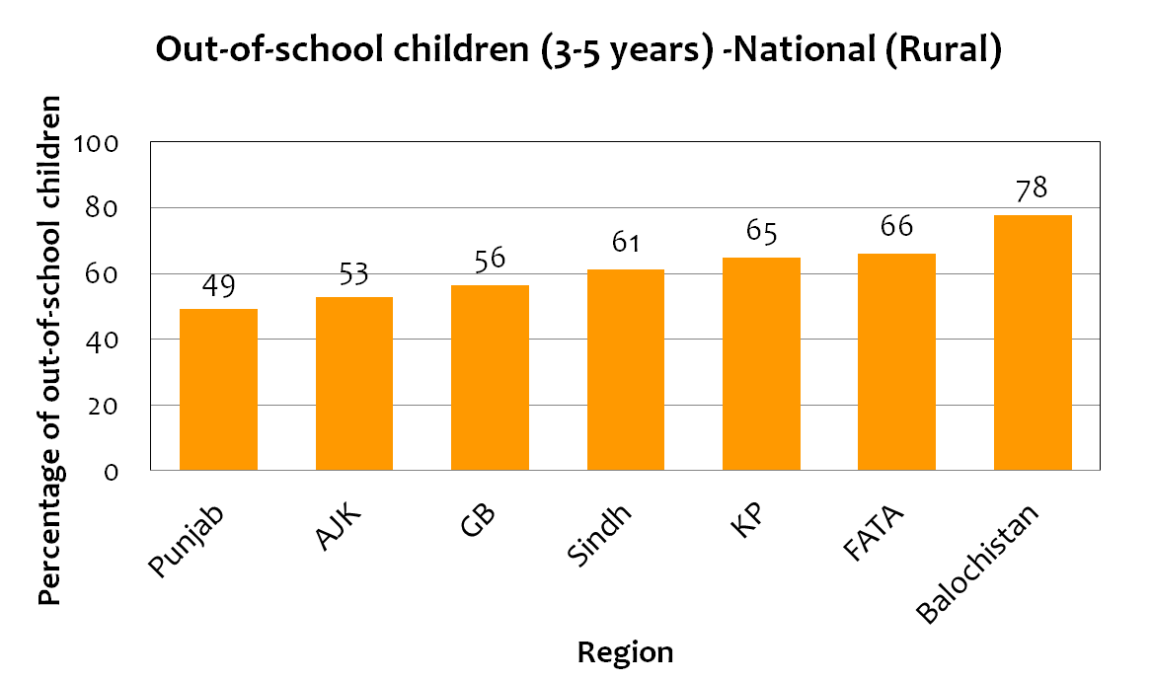
Provincial Trends (rural)-
Out of School Children
ASER 2012 – National (Rural)
Notes:
The number out of children vary quite a lot across Provinces – even richer, better performing performances like Punjab have almost half of children out of school. In more unstable areas marred by natural and man-made disasters, the numbers go further up.

Slide 6
Children not attending any pre-school 3 to 5 yrs
Enrollment of children of 3 – 5 years 37% in 2012
Enrollment highest in Urban 55% compared to Rural 37%
ASER 2012 – National (Rural)
Notes:
ASER covers 136 Rural districts of Pakistan - These figures are based on the ASER Survey of 4,033 households in 80, 209 villages in the country where a total number of 57, 503 children (47% girls, 53% boys) were found in this age group. The estimates done by provincial governments are sometimes even higher than the trends shown through ASER 2011 and 2012 data (for e.g., Balochistan).
ASER Survey 2012 once again highlights that the basic issue of access to Early Childhood Education is not addressed. Almost 63% children between age 3-5 years are not receiving any formal or informal education focusing on the core domains of holistic development. This is highest for age 3 children 91% of them remaining out of school. While the percentage of out of school children significantly drops at age 5, with only 62.2 attending the school, the right to education ensured by Article 25-A is not realized for 37.8 % of children of the surveyed households across Pakistan. For the pre-primary age group (3-5yrs), provincial figures are even more alarming with the lowest range at 50% out of school children in Punjab and highest at 78% in Balochistan.

Slide 7
Transitions ECE, Primary & Middle Levels- National and Provincial
REGION AND PROVINCE | GER ECE, NET PRIMARY and Elementary Level ENROLMENT (PERCENT)
 | 2011-2012 GER ECE (Age 3-5) |  |  | 2011-12 NER Primary (Age 6-10) |  |  | 2011-12 NER Middle (Age 11-13)
 | MALE | FEMALE | BOTH | MALE | FEMALE | BOTH | MALE | FEMALE | BOTH
Pakistan | 43 | 41 | 44 | 72 | 63 | 68 | 41 | 33 | 38
Punjab | 49 | 50 | 50 | 77 | 72 | 74 | 43 | 38 | 40
Sindh | 33 | 31 | 32 | 65 | 53 | 59 | 39 | 29 | 34
KPK | 39 | 45 | 41 | 72 | 59 | 66 | 41 | 30 | 36
Balochistan | 25 | 41 | 30 | 59 | 36 | 49 | 32 | 14 | 24
Source PSLMs 2011-2012

Slide 8
ECE: What is promised
(National Education Policy -NEP 2009 & Article 25 A – Right to Education –for 5-16 years 2010)
Recognition and strengthening of Katchi class as part of formal system (17-19% children in primary schools are in Katchi /Pre primary classes) and mostly in the public sector.
At least one year pre-primary education shall be provided by the State and universal access to ECE shall be ensured within the next ten years. (KP two years pre –primary )
Provision of financial and food support to children who drop out because of poverty at ECE
Two year pre-service training to ECE teachers based on NCECE

Slide 9
Policy Actions for ECE – NEP 2009
 | Improvements in quality of ECE shall be based on a concept of holistic development of the child that provides a stimulating, interactive environment, including play, rather than a focus on regimes that require rote learning and rigid achievement standards.
 | ECE age group shall be recognized as comprising 3 to 5 years. At least one year pre- primary education shall be provided by the State and universal access to ECE shall be ensured within the next ten years.
 | Provision of ECE shall be attached to primary schools which shall be provided with additional budget, teachers and assistants for this purpose.
 | For ECE teachers, a two-year specialized training in dealing with young children shall be a necessary requirement.
 | This training shall be on the basis of the revised ECE National Curriculum. The curriculum and support material for ECE shall take account of the cultural diversity of particular areas. (chapter 5 NEP 2009)
Policy Action 1
Policy Action 2
Policy Action 3
Policy Action 4
Policy Action 5

Slide 10
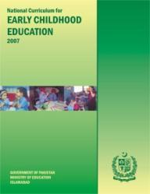
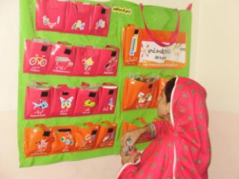
Quality - Excellent National Curriculum & Standards -
ECE National Curriculum 2007 – a comprehensive holistic document developed with best practitioners in the country (upgraded the 2002 document)
Early Learning Development Standards (ELDS) 2009 (not validated)
In 2012-13 consultations held on Learning Metrics Task Force for Early Years – 7 Domains
Training modules and learning materials for ECE in all provinces: innovative programs by CSOs, INGOs & donors
Textbooks/materials can be produced by multiple providers through open advertisement - space for innovation

Slide 11
ECE in Pakistan: What we have…
National Curriculum 2007 aligned with the developmental domains
  Contextualized, consultative and research based
Frameworks for classroom implementation in rural and urban areas for ECE
Early Learning Development Standards (ELDS) – validation still not done
Specific policies for ECE introduction, budgetary provisions and plans across Pakistan- influenced by practitioners, CSOs- academia- activists- rights based – holistic – public sector convinced but institutionally not well provisioned for ‘ECE’.
  Sindh Sector Plan
  Balochistan Sector Plan
  Punjab ECE Sector Plan
  KP Sector Plan
  RTE Acts in ICT, Sindh and Ordinance in Balochistan
A robust mix of technical and grassroots expertise for Teacher Education, best practices; innovations follow-up and support

Slide 12
Are Schools Ready?
Teachers – profiling for ECE
  Appointment & allocation
    New positions not created – a cadre for ECE teachers does not exist in public sector
    1 teacher for each of the 5 grades formula for calculating HR needs, ECE is not included in budgeting cycle
  Attitude, interest, physical stamina & attributes -
  Content knowledge and pedagogy– learning, child development domains/ stages, active learning strategies
  Pre-service: until recently TE was based on rote learning without specific ECE focus, leakages in evaluation frameworks.
    New 2yr programmes designed yet to be rolled out but one year B.Ed ECE exists
  In-service: no framework for ECE, entirely through small-scale funded-projects.
    Teachers who are trained are often not regular teachers for ECE –
  (Amima Saiyid .. And Baela R. Jamil – CIES 2013)
Notes:
While school readiness of children is considered, an equally important question is whether schools are ready for children? The first and most important factor is availability of competent, energetic teachers. Public schools struggle with layers of issues when it comes to teachers for ECE.

Slide 13
Sector Plans in Pakistan- 2010-2013 A Provincial Business after 18th Constitutional Amendment 2010
After the 18th Amendment, Education completely devolved to the provinces and areas -
Draft Sindh Education Sector Plan (SESP)- 2014-2018 - Sindh eligible GPE Funding US $66 Million
ESP developed consultatively with a large Local Education Group (LEG) – CSOs/Academia/Private sector; Govt. etc.
Objectives of Sindh Sector Plan – Draft ( each one with a log frame)
Develop ECE/ECD policy and minimum standards for ECE (e.g., space, enrollment, teacher requirements, teaching learning material, assessment etc.)-
Enhance ECE NER from 32 percent to 45 percent through phase-wise establishment of 121 model ECE Resource Centres across the province and transforming 8000 katchi into ECE classes Establish ECE teachers’ cadre (recruit and train 8121 teachers)
Review and revise ECE curriculum 2007 and ensure provision of teaching learning materials, as prescribed in the ECE-curriculum
Support learners’ transition from ECE to class I (Primary)

Slide 14
Objectives | Strategies | Targets (2014-2018) | Activities
Strategic Objective 1 Develop ECD/ECE policy and minimum standards for ECE | Mobilizing stakeholders for dialogue, policy approval/ legislation Documentation of the existing ECE models, particularly, in Pakistan and at international level Development of Standards | By the end of 2014, ECD/ECE policy options are developed and approved through legislation Minimum standards for ECE developed and approved E&LD by 2014 and disseminated Sindh to become member of ECD/ECE national, regional and global professional networks | Arranging dialogues on ECD/ECE policy through consultative process Holding technical dialogues on the minimum standards (hard/soft) Ensuring that both public and private schools are following ECE standards
Strategic Objective 2 Establishment of model ECE Resource Centers across the province and transforming katchi classes into ECE classes | Establishment of model ECE centers at every district and taluka level in existing schools with space Development of initial teacher education diploma for ECE teachers Hiring teachers through merit based recruitment Private sector engagement for professional development and TLMs Regular review of ECE learning resource materials Community engagement for the promotion of ECE | By 2018 to enhance ECE NER from 32 percent to 45 percent 121 ECE Resource Centers established, equipped and running by 2016. By the end of 2018, at least 8,000 Katchi classrooms are transformed into ECE classes (in public sector schools) | Identify the schools based on established criteria Set up the 121 ECE model resource centers in target schools Establish proper ECE classrooms in selected government schools Explore private sector partnerships for meeting ECE targets. Mobilize SMCs and community for ECE enrollment and support
DRAFT
ONlY

Slide 15
Punjab Education Sector Plan 2013-18
Strategic Objective:
The sector plan has set an objective to establish ECE program in all primary schools in Punjab.
Key Strategies:
Key strategies on ECE, described in the sector plan are to:
Institutionalize pre-primary ECE through development and notification of a policy
Create awareness and train education managers, head teachers and teachers on ECE.
Prepare plan and implement expansion of pre-primary ECE programs to 5000 primary schools

Slide 16
Financing ECE- template for costing
The Template for ECE planning and financing in Sector Plans of Provinces has the following possible elements:
Population Baseline
Population Projections annually
% ECE enrolment in Public Sector Schools and % in Private Sector
% enhancement of NER ECE 2014-18
5% Growth rate assumed/projected for private sector
% places subsidized or bought through vouchers by public sector through education foundations or specific delivery programs

Slide 17
A typical costing sheet ESP – (Sindh)
Population Enrolment Projections annually Rooms
ECE Model Resource Centers (e.g. Rs. 3.5 million each)*
Recruitment/Salaries Teachers and Assistants /Support Staff
Teacher Training
Teaching Learning Materials and textbooks
ECE/ECD Policy/Research
Subsidies/vouchers to private sector not reflected but are already being given for ECE and Primary through the
Education Foundation

Slide 18
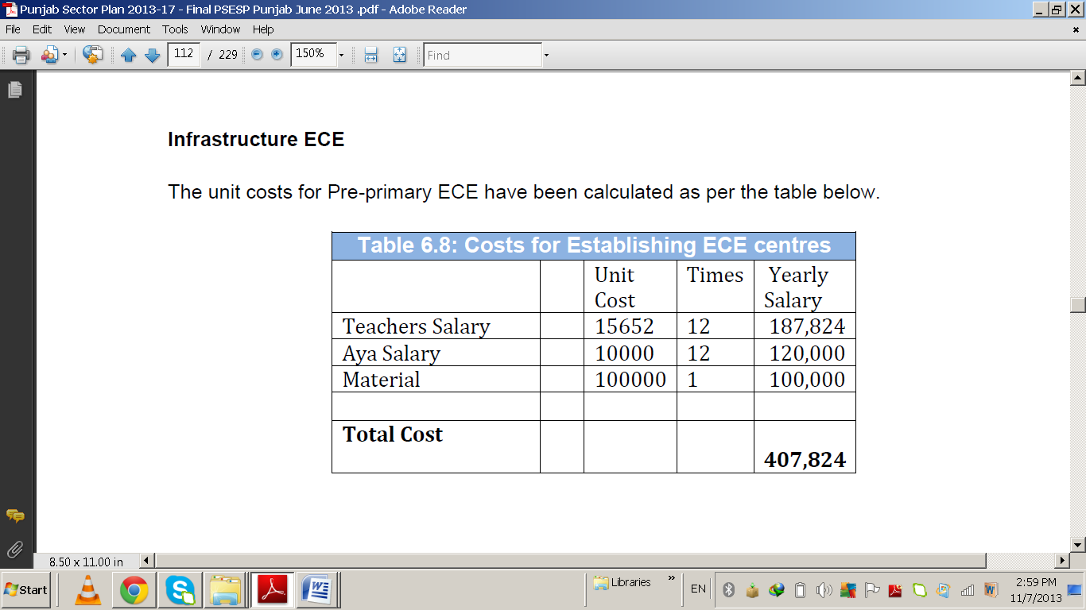
Punjab ESP – ECE Costing – a minimalist approach
Additional Children in Schools
 | 2013-14 | 2014-15 | 2015-16 | 2016-17 | 2017-18 | Total
ECE | 230472 | 252197 | 276086 | 302356 | 331246 | 1392357
Costing for Infrastructure separately under “Missing Facilities”

Slide 19
Balochistan Costing 2014-18
Strategic objective:
In line with the above, the Sector Plan recommends preparing a policy framework for ECE, educating society and education managers on benefits of ECE as a foundation for quality education. The framework includes a mechanism for monitoring implementation and a process of ongoing research for improvements. The main objective is to “Institutionalize ECE teaching into all primary schools in the public sector
Strategies:
Prepare a policy framework for ECE
Increase awareness among educational planners and implementers
Phase wise expansion of ECE 2014-2018
Enhance allocation to ECE up to 5% of the Provincial Education Budget

Slide 20
Assumptions in Costing- Sindh - ESP/GPE
Technical Notes and Assumption for the Sindh Education Sector Plan (SESP) 2014-18
Baseline calculated from PSLM 2011-12 and SEMIS
Enrolment projections from 2014-18 are using enrolment figures from 2013-14 with implications for higher figures than the baseline for that year
Assumption of Public and Private provision is 64 percent (public) and 36 (private) percent-
Private sector growth is assumed at the rate of 5 percent per annum based on its own resources
Government is open to providing subsidy/vouchers /grant-in-aid to private sector providers to support SESP targets based on the assumption of 64:36% public private provision
PPPs to be embraced covered by the amended legislation Sindh PPP Act 2010 to include services
Where rooms are added they are also overlapping with upgradation/consolidation
Where teachers recruitment is listed it also carries new posts for upgradation – final need for recruitment subject to adjustment in numbers after rationalization in accordance with the needs
Where upgradation of primary to middle and middle to secondary/higher secondary is reflected it would carry actions for level re-categorisation in SEMIS database and other necessary operational matters

Slide 21
Sources of Financing for ECE –ECD
Government of Pakistan - 92-95% - through public sector financing
ODA 5-8%
Donors in ECE : AusAid; USAID, UNICEF; UNESCO , CIDA; DFID INGOs – Save the Children; Plan, Oxfam GB ; AKF; OSF (research/baseline) Dubai Cares etc. - ..
Private Sector : 29 % rural 50-60 % urban presence, both, for and not for profit
PPPs Policy : Since 2002 policy guidelines on PPPs – encouraged with incentives- access to public sector facilities – not necessary transfer of resources for sharing risks with outcomes
2009 -2010 PPP Laws emerge in two provinces (ADB Led) but ‘infrastructure oriented’- services only related to infrastructure.
                Under ESPs provinces are looking to expand the scope of PPP Laws to include services exploring – procurement of services for education including ECE – Services include: ‘mobilization for enrolment; school improvement curriculum, training, quality assurance, research , design etc.

Slide 22
Costing in ECE very new and fragile
ECE traditionally a ‘forgotten sub-sector” – ECD yet to be discovered beyond ‘conversations’ , pilots and research
In 2001-2015 EFA National Plan- ECE was costed traditionally – minimally
In 2001-2005 Education Sector Reforms (ESR) Action Plan the first innovative program for ECE costed and funds transferred from federal government to provincial govts. – had a huge impact (evaluated) – that template remains “stuck “as seen in the Punjab Costing for ESP 2014-2018
Little understanding of the sector within institutions/ministries – education, finance and planning
Allocations do not always mean expenditures ..! Punjab allocated Rs. 200 million in 2012-13 but did not spend and money was used elsewhere!
PPPs – some global best practices in Pakistan exist in ECE /ECD too need scaled up – govt . ‘buy in’/legal cover
In Departments there is no special unit for ECE – in some provinces ECE led by the in-service teacher training institutions (Punjab)
ECE has a long way to go must be linked to 25 A – it has been recognized and costed under provincial ESPs
Budget tracking needs to be done with baseline established on ECD/ECE by civil society – ASER/I-SAPs and Education/Planning/Finance Depts to see if they have ‘walked the talk”
Would be worthwhile to build capacity on ‘costing’ of ECD/ECE of appropriate teams across sectors

Slide 23
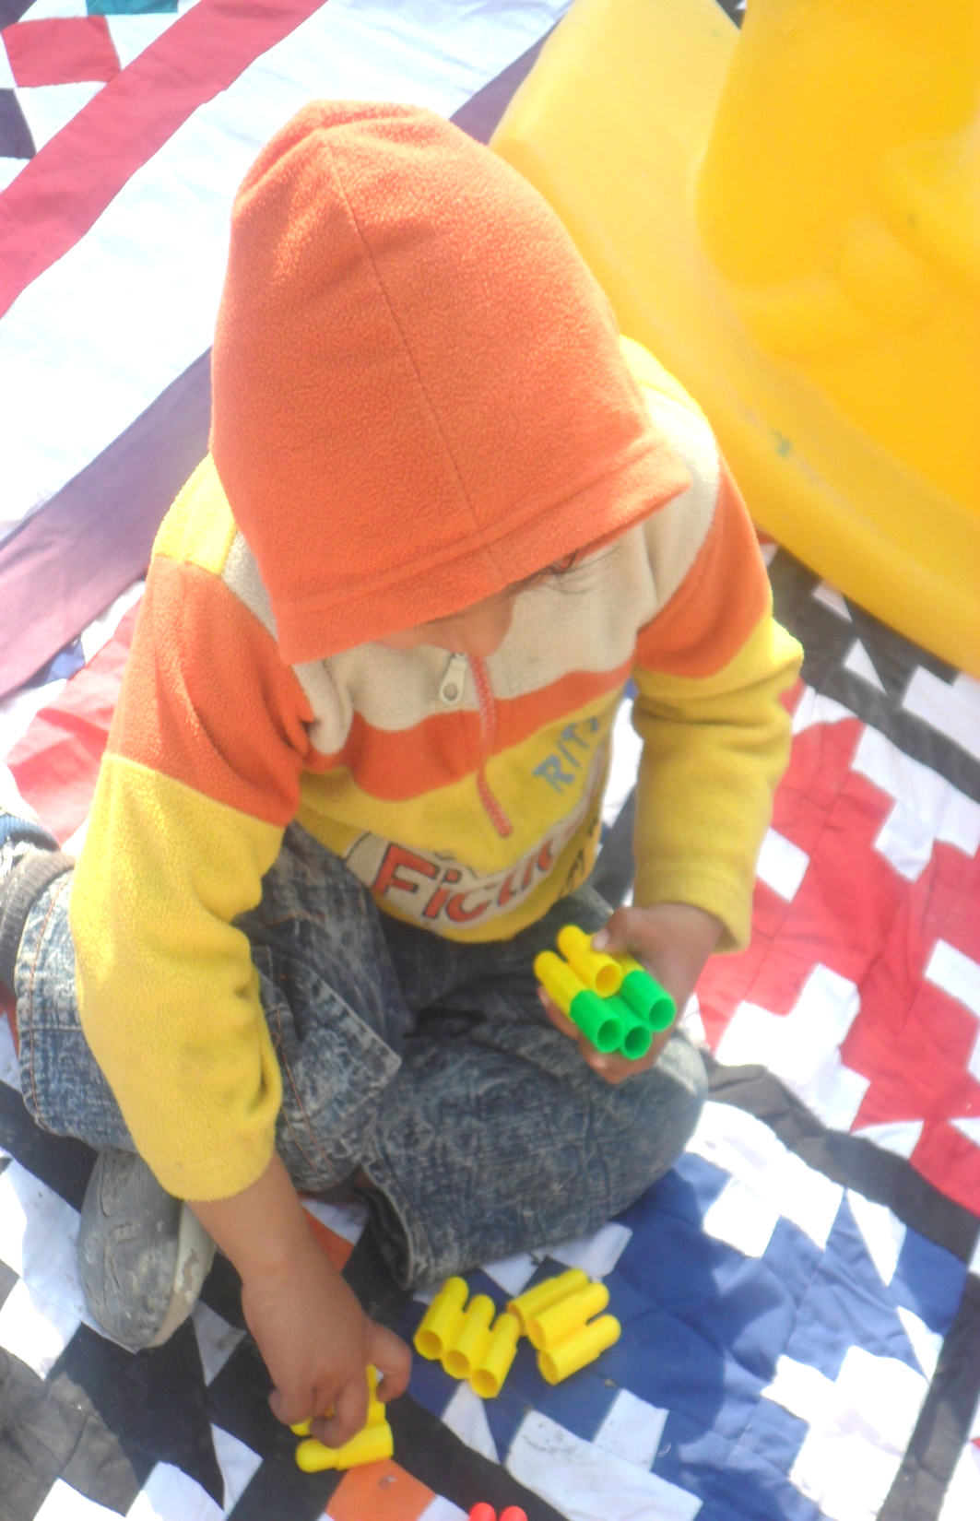
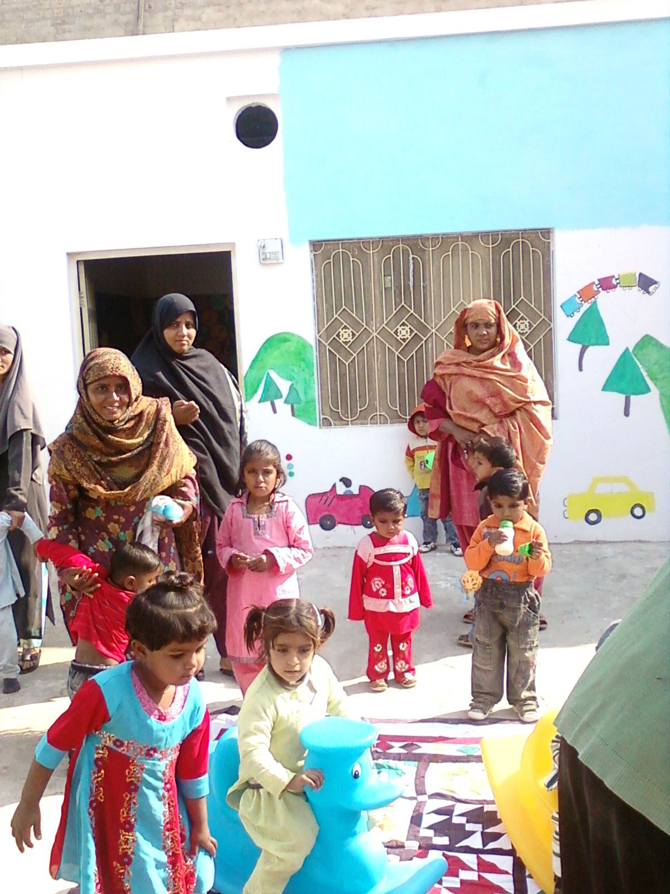
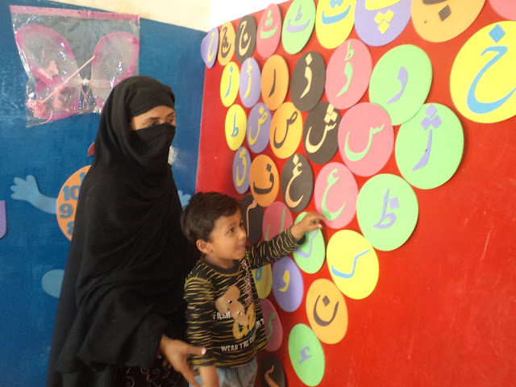
Thank You

Slide 24
Annex- ASER 2012 – SAMPLE DISTRIBUTION
 |  |  |  | Children (3-16 Years) |  |  |  | Schools
National | Districts Covered | Villages/ Blocks | House Hold | Female | Male | Total | Mothers | Gov. | Pvt. | Total
Rural | 136 | 4,033 | 80,209 | 101,236 | 143,241 | 244,477 | 81,417 | 3,934 | 1,660 | 5,594
Urban | 6 | 193 | 2,312 | 2,930 | 4,037 | 6,967 | 2,329 | 183 | 167 | 350
Rural + Urban | 142 | 4,226 | 82,521 | 104,166 | 147,278 | 251,444 | 83,746 | 4,117 | 1,827 | 5,944

